Slide 1
IMAGE CATEGORISATION
COMPUTER VISION CMP-7026B
Daniel Campoy and Liam Self
SCHOOL OF
COMPUTING SCIENCES

Slide 2
OVERVIEW
Performed image classification experiments using three feature selection methods
Bag of SIFTs (Scale-Invariant Feature Transform)
Spatial Pyramid Matching
Histogram of Oriented Gradients (Bag of HOGs)
Tested three classifiers
k-Nearest Neighbours (kNN)
Support Vector Machine (SVM)
Naïve Bayes
Explored addition of colour-based SIFT features in Bag-of-SIFTS and Spatial Pyramids)

Slide 3
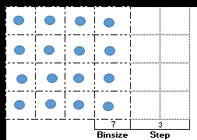
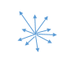
Bag of SIFTs
Uses vocabulary derived from SIFT features clustered using k-Means clustering
Bag of SIFTs performs SIFT feature collection on new images with a 4x4 kernel and specified binsize and step
Histogram formed by assigning each feature to nearest ‘word’ in vocabulary
We used binsize of 7 with step of 3 to build vocab
Each bag of SIFTs used the same binsize
of 7 and Step 10
Notes:
Binsize contains x number of pixels, the kernel steps n number of pixels and each bin will contain an accumulated gradient spatial base from x pixels
Creating a histogram of feature
counts describing an image based on the
closest distance between the feature and “word” within the bag of words

Slide 4
SPATIAL PYRAMIDS
Extension of basic bag-of-SIFTs method
Recursively splits image into increasingly small cells
Histograms computed for SIFT features within each cell
Each histogram weighted inversely proportional to the cell size
Because features are grouped according to their location, in theory this increases accuracy over unordered bag-of-SIFTs by retaining spatial information
Top image: Lazebnik et al, 2006

Slide 5
EXTENDING SIFTs WITH COLOUR INFORMATION
Several different methods available for augmenting SIFTs with colour information
Eg HSV-SIFT, Opponent-SIFT, Transformed RGB, rg-SIFT and w-SIFT
Each has pros and cons with respect to invariance to certain properties

Slide 6
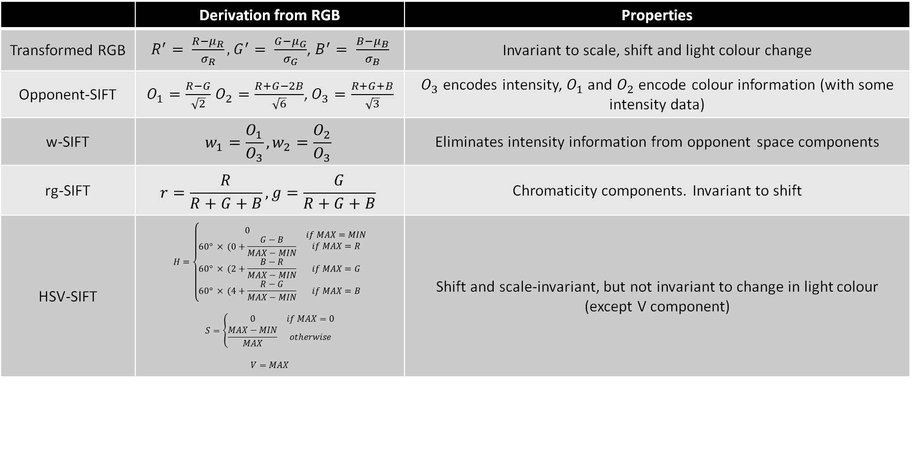
SUMMARY OF COLOUR FEATURES
 | Derivation from RGB | Properties
Transformed RGB | $R^{′}= \frac{R−μ_{R}}{σ_{R}},G^{′}= \frac{G−μ_{G}}{σ_{G}}$, $B^{′}= \frac{B−μ_{B}}{σ_{B}}$ | Invariant to scale, shift and light colour change
Opponent-SIFT | $O_{1}=\frac{R−G}{\sqrt{2}}$ $O_{2}=\frac{R+G−2B}{\sqrt{6}}$, $O_{3}=\frac{R+G+B}{\sqrt{3}}$ | $O_{3}$ encodes intensity, $O_{1}$ and $O_{2}$ encode colour information (with some intensity data)
w-SIFT | $$w_{1}=\frac{O_{1}}{O_{3}},w_{2}=\frac{O_{2}}{O_{3}}$$ | Eliminates intensity information from opponent space components
rg-SIFT | $$r=\frac{R}{R+G+B}, g=\frac{G}{R+G+B}$$ | Chromaticity components. Invariant to shift
HSV-SIFT | $$H=\left\{\begin{matrix} \\ \begin{matrix}\begin{aligned}0 \\ 60° × (0+\frac{G−B}{MAX−MIN}\end{aligned} & \begin{aligned}if MAX=MIN \\ if MAX=R\end{aligned} \\ 60° × (2+\frac{B−R}{MAX−MIN} & if MAX=G \\ 60° × (4+\frac{R−G}{MAX−MIN} & if MAX=B\end{matrix}\end{matrix}\right.$$ $$S=\left\{\begin{matrix}0 & if MAX=0 \\ \frac{MAX−MIN}{MAX} & otherwise\end{matrix}\right.$$ $$V=MAX$$ | Shift and scale-invariant, but not invariant to change in light colour (except V component)

Slide 7
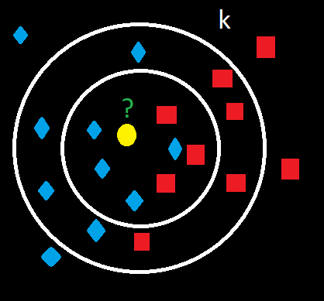
kNN Classifier
K - Nearest Neighbour is a lazy learner
Matching a feature vector to the k closest features
A k value determines search area
Notes:
Finding the right size of the search area helps determine its accuracy
K-nearest neighbour performs well with large feature vectors which is what you will see in the next slide

Slide 8
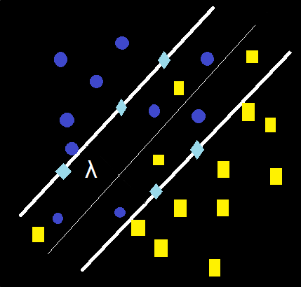
SVM Classifier
A binary classifier producing a 1 or -1
Hyperplane location is decided by maximising distance from ‘support vectors’ from a subset of data points
SVM accuracy is highly influenced
by λ
Measure of degree of misclassifications allowed between two classes
Higher value = more strict
Our best λ is 0.00001 (Discussed later)
Notes:
These are the closest to the hyperplane. An SVM will find the best optimal location and based on its lambda produces a wide or narrow width of the hyperplane.
Larger λ = fewer misclassifications
permitted
The size of Lambda has a direct effect on its performance, the closer it is to zero the longer it takes to find the optimal support vectors. In one case the run time increased by 10 fold when using 1e-6 to 1e-7.
Increasing this value (closest to 1) narrows the hyperplane decreasing the number of misclassifications allowed
Decreasing (closest to 0) lambda performs the inverse

Slide 9

MULTINOMINAL NAÏVE BAYES CLASSIFIER
Probabalistic classifier
Based upon Bayes’ Theorem $p\left(C_{k} | x\right)=\frac{p(x|C_{k})p(C_{k})}{p(x)}$
Multinominal Naïve Bayes suitable for nominal (eg histogram) data
Estimates the conditional probability of the presence of a given attribute for a given category based on the relative frequency of that attribute in training image belonging to that category
Calculate log-likelihood for each category (as summation of log likelihoods for each attribute), weighted by $p(C_{k}$) , highest-scoring category is used to classify.
$p\left(x\right)$ can be ignored as this will always be the same within each classification.
Previous work has been conducted around use of Naïve Bayes classifiers with HOG features, (Nirmala et al, 2017)

Slide 10
Experiments
Effect of varying Vocab Sizes for Bag of SIFTs, Spatial Pyramids, HOG, HOG+hist, SVM, kNN, and Naïve Bayes
Colour space vs Greyscale for Bag of SIFTs and Spatial Pyramids
Transformed RGB
HSV-SIFT
rg-SIFT
Opponent – SIFT
w-SIFT
How the number of levels influence Spatial Pyramids
Influence of k value within a kNN classifier
λ influence on a SVM classifier

Slide 11
SVM Accuracy with Bag of SIFTs
Notes:
Vocab size of 250 to 350 for most models are acceptable for bag of sifts
We see 450 produces the highest accuracy but the gains between 250 – 350 are minor expect for greyscale which produces a overall gain as the bag size increases
Measuring beyond 450 vocab size will decrease in accuracy as there are too many bins thus limiting the model to generalise

Slide 12
kNN Accuracy with Bag of SIFTs
Notes:
Cityblock distance measure
We see as the vocab size increases its accuracy also increases regardless of k value
However with a k value of 11 or 15 shows this is the optimal k value with bag of sifts and HOG feature selection achieving a peak accuracy of 54% for Bag of SIFTs HSV
Overall similar grain between modes between different k values

Slide 13
SPATIAL PYRAMID PERFORMANCE: SVM
Notable increase in accuracy in comparison to standard Bag-of-SIFTS
Maximum greyscale accuracy achieved with SVM of 63.2% using 3 levels, SVM
λ=10⁻⁵, step size 10, 350-word vocabulary
Peak reached at 2 levels (image partitioned into 4x4 cells)
3 levels resulted in no increase, beyond this accuracy decreased
Too high a cell resolution results in too small a cell to detect prominent image features

Slide 14
SPATIAL PYRAMID PERFORMANCE: SVM
Tested each colour method with SVM using varying vocabulary size
In general, all tested colour models performed better than greyscale.
rg-SIFT performed comparatively poorly, particularly at high vocab sizes
With all methods, diminishing returns from vocab size of 250

Slide 15
SPATIAL PYRAMID COLOUR PERFORMANCE: kNN
kNN performed well when using cityblock (“Manhattan”) distance, but very poorly using Euclidean, regardless of colour method used
Euclidean metric unsuitable
Smaller, high-weighted cells of pyramid are sparse histograms – at high vocab sizes, most bins are 0
kNN suffers from ‘curse of dimensionality’ – performance decreases with size of feature vector
Optimum value of k around 9-15 before plateauing.
SVM remains more suitable classifier
Notes:
Graph is best performing colour method (Transformed RGB)

Slide 16
λ Comparison
Notes:
Lambda comparison shows as the value becomes closer to zero we see an increase and drop off of gains beyond .00001

Slide 17

HISTOGRAM OF ORIENTED GRADIENTS (HOG)
Calculate intensity gradients for each pixel in image (horizontal $g_{x}$ and vertical $g_{y}$ components) Simple gradient kernels: Also possible to use Sobel kernels (not implemented here)
Calculate gradient magnitude $g=\sqrt{{g_{x}}^{2}+{g_{y}}^{2}}$, angle $θ=\text{arctan}\left(\frac{g_{y}}{g_{x}}\right)$
Partition image into cells of NxN pixels
For each cell, produce histogram, allocating each pixel gradient according to its absolute angle |𝜃|, weighted by its magnitude
Typical bin size 20°
Each gradient is interpolated between bins proportionally
Eg. A gradient of magnitude 40 and angle 25° would contribute 10 to 20° bin and 10 to 40° bin
Apply block normalisation to each 2x2 block of cells
Normalising histograms makes features less variant to changes in contrast
Concatenate blocks to form feature vector
(Bag features together into vocabulary in similar fashion to Bag-of-Words)
-1
-1
0
1
0
1

Slide 18
HOG FEATURE PERFORMANCE
Using HOG alone resulted in moderate results - 51% max when using SVM classifier
Naïve Bayes classifier outperformed by other classifiers. Accuracy plateaued relatively fast with increased vocabulary size.

Slide 19
NAÏVE BAYES CLASSIFIER
Naïve Bayes surprisingly accurate at low vocabular size, but decreases afterwards for most features
Adding colour information has little effect
Assumption that features are independent may be a cause
Spatial pyramid overtaken by Bag of SIFTS after bin size of 200
HOG features perform poorly but high accuracy maintained for Underwater, Forest and Tall Building

Slide 20
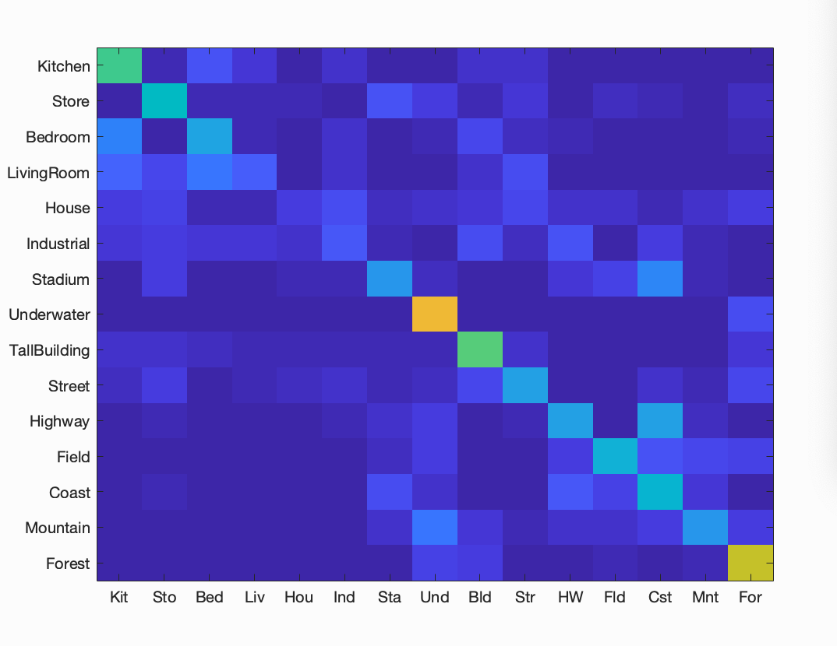
NAÏVE BAYES CLASSIFIER
Naïve Bayes surprisingly accurate at low vocabular size, but decreases afterwards for most features
Adding colour information has little effect
Assumption that features are independent may be a cause
Spatial pyramid overtaken by Bag of SIFTS after bin size of 200
HOG features perform poorly but high accuracy maintained for Underwater, Forest and Tall Building

Slide 21
COMBINING HOG FEATURES
Also tried combining HOG features with other image descriptors such as colour histograms and tiny images
Combining HOG features with tiny image feature (RGB values of images resampled to 4x4px resulted in 5-8% increase in accuracy versus HOGs along
However concatenating with colour histogram data reduced accuracy

Slide 22
SUMMARY
While all three feature selection methods produced promising results, spatial pyramid was best performing
Inclusion of colour-based SIFT features mostly resulted in increased classification accuracy
Transformed-RGB SIFT features offered higher gain in accuracy among those evaluated
HOG Features performed moderately well, but not more effectively than Bag-of-SIFTS or Spatial Pyramids
Naïve Bayes underperforms compared to other classifiers – especially using HOG features. Level of co-dependence between attributes may be factor

Slide 23
REFERENCES
S. Lazebnik, C. Schmid and J. Ponce, "Beyond Bags of Features: Spatial Pyramid Matching for Recognizing Natural Scene Categories," 2006 IEEE Computer Society Conference on Computer Vision and Pattern Recognition (CVPR'06), New York, NY, USA, 2006, pp. 2169-2178.
K. Nirmala, N. Venkateswaran and C. V. Kumar, "HoG based Naive Bayes classifier for glaucoma detection," TENCON 2017 - 2017 IEEE Region 10 Conference, Penang, 2017, pp. 2331-2336.
VLFeat.org. (2018). Retrieved May 7, 2019, from http://www.vlfeat.org/api/dsift.html
K.vandeSande,T.Gevers,andC.Snoek,“Evaluationofcolordescriptorsforobjectand scenerecognition.”inProceedingsofCVPR,2008.
S.Lazebnik,C.Schmid,andJ.Ponce,“Beyondbagsoffeatures:Spatialpyramidmatching forrecognizingnaturalscenecategories,”inProceedingsofthe2006IEEEComputer SocietyConferenceonComputerVisionandPatternRecognition-Volume2,ser.CVPR’06. Washington,DC,USA:IEEEComputerSociety,2006,pp.2169–2178.[Online].Available: http://dx.doi.org/10.1109/CVPR.2006.68

